Slide 1
Entity Relationship Diagram 1/3
School of Computing and Engineering

Slide 2
Recap from the previous lecture
What is requirement? Describe by specifying the different types of requirements.

Slide 3
Requirement
A requirement is an statement of what the system must do or what characteristics it needs to have. During a systems development project, requirements will be created that describe:
What the business needs (business requirement);
What the users need to do (user requirements);
What the software should do (functional requirements);
What characteristics the system should have (non-functional requirements);
How the system should be built (system requirements).

Slide 4
Review the Amazon.com Web site. Create a list of functional requirements that the system meets. What different kinds of non-functional requirements does the system meet? Provide examples of each kind.

Slide 5
Answer (1/2)
Functional Requirements
The system should :
enable user to find item(s) based on variety of item characteristics
enable user to look through items
enable user to select and purchase items
enable user to submit his/her comments on items and read other users' comments on items
enable site to remember user's preferences based on previous use of the site and orders placed
enable user to participate in registry (e.g., wedding, baby); enable users to search registries
enable user to create and maintain a wish list of desired items; enable users to search a person's wish list for gift ideas.

Slide 6
Answer (2/2)
Non-functional Requirements
Operational - the system should work on any web browser
Performance - the system should be available 24/7/365.
Security - the system enables registered customers to review their own accounts
Cultural - the system exists in versions tailored to global users, e.g., French, Japanese, German, etc.

Slide 7



Input
Process
Output
Analysis
Systems Development Process
Planning
Implementation.
Analysis
Design
Systems Analysis and Design is about getting people, processes and technology together to sort out the bit in the middle!

Slide 8
Analysis
Step | Technique | Deliverable
Develop Analysis Strategy | Business Process Automation Business Process Improvement Business Process Reengineering | System Proposal -Requirements Definition -Use-Cases -Logical Process Models -‘DFD Process Logic’ Specification (Logic Model) -Logical Data Model
Determine Business Requirements | Interview Joint Application Design (JAD) Questionnaire Document Analysis Observation
Create Logical System Models | Use-Case Analysis Data Flow Diagramming (DFD) Process Specification e.g. Structured English Entity Relationship Diagramming Normalisation

Slide 9
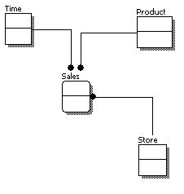
Logical Data Model
During the analysis phase, the data model presents the logical organisation of data without indicating how the data are stored, created, or manipulated so that analysts can focus on the business without being distracted by technical details.
Later during the design phase, the data model is changed to reflect exactly how the data will be stored in databases and files.

Slide 10
Data Model
A data model is a formal way of representing the data that are used and created by a business system;
It illustrates people, places or things about which information is captured and how they are related to each other.
During the analysis phase, analyst draw a logical data model, which shows the logical organisation of data without indicating how data are stored, created, or manipulated.
This model is free of any implementation or technical details, the analyst can focus more easily on matching the diagram to the real business requirements of the system.

Slide 11

Entity Relationship Diagram (ERD)
ERD developed by Dr Peter Chen (picture shown above) in 1976 is one of the most commonly used techniques for data modelling.
An ERD is model that shows the information which is created, stored, and used by a business system.
An analyst can read an ERD to discover the individual pieces of information in a system and how they are organised and related to each other.
ERD represents information grouped together in boxes called entities and lines are drawn to show relationships among the data.

Slide 12
Creating an ERD
The basic steps in building an ERD:
Identify the entities;
Entity: a person, place, object, event or concept in the user environment about which data is to be maintained.
The entity is the basic building block for a data model. It is a person, place, event, or thing about which data is collected. E.g. an employee, an order and a product
Entities represent something for which there exist multiple instances, or occurrences.
E.g. John Smith could be an instance of the Student entity.
University
Student
Lecturer

Slide 13
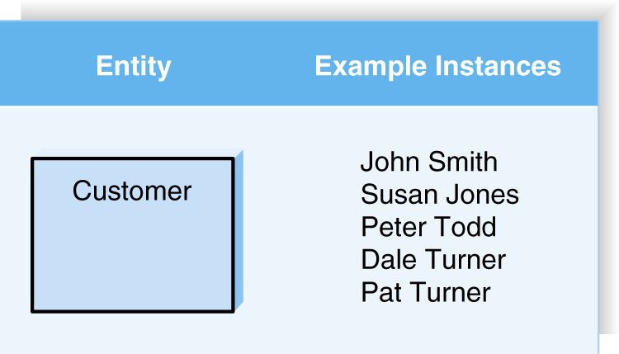

Slide 14
2. add the appropriate attributes to each entity;
Attribute: a named property or characteristic of an entity that is of interest to the organization
Naming an attribute: i.e. Vehicle_ID
Place its name inside the rectangle for the associated entity in the ERD.
An attribute is some type of information that is captured about an entity.
Attributes are nouns that are listed with an entity.
University
Name
Enrolment
Date Founded
President
Student
Name
Address
Telephone
Age
Lecturer
Name
Module Leader
Research
Qualification

Slide 15
3. draw relationships among entities.
Relationship: an association between the instances of one or more entity types that is of interest to the organization.
….how the entities are related to each other.
Lines are drawn between the entities that have relationships.
University
Name
Enrolment
Date Founded
President
Student
Name
Address
Telephone
Age
Lecturer
Name
Address
Research
Qualification
require
have

Slide 16
4. Identify cardinality
Most relationships are not one-to-one
For example a manager usually manages more than one employee
This is described by the cardinality of the relationship for which there are four possible categories:
One to one (1:1) relationship
One to many (1:m) relationship
Many to one (m:1) relationship
Many to many (m:n) relationship
On an ERD if the end of a relationship is straight it represents 1 while a “crow’s foot” end represents many.
University
Name
Enrolment
Date Founded
President
Student
Name
Address
Telephone
Age
Lecturer
Name
Address
Research
Qualification
require
have

Slide 17
5. Identify modality
A relationship have a modality of null or not null which refers to whether or not an instance of a child can exist without a related instance in the parent entity.
It indicates whether the child-entity instance is required to participate in the relationship.
It ask question like:
Can you have a university without any student?
University
Name
Enrolment
Date Founded
President
Student
Name
Address
Telephone
Age
Lecturer
Name
Address
Research
Qualification
require
have

Slide 18
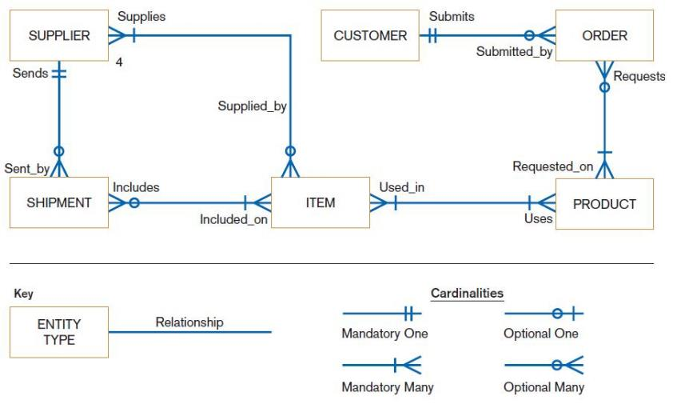
ERD

Slide 19
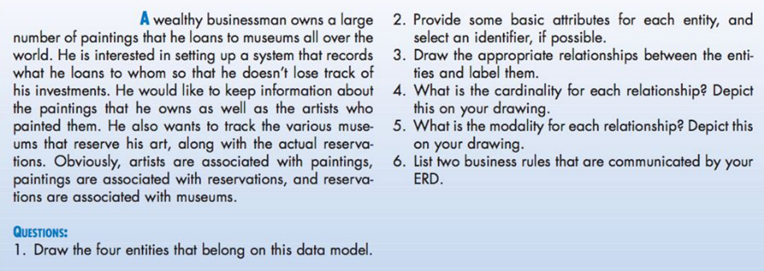
Activity

Slide 20
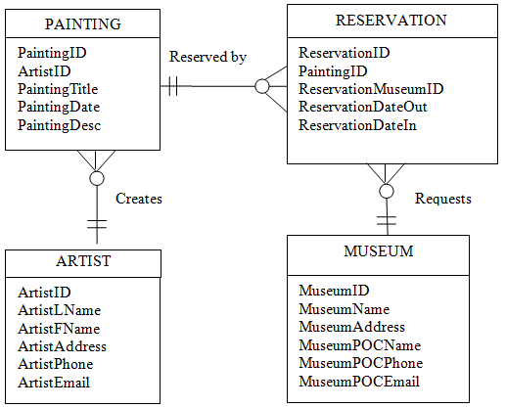
Answer to the class exercise

Slide 21
Designing an ERD
What are subjects/objects of the business?
Data entities and descriptions
What unique characteristics distinguish between subjects/objects of the same type?
Primary keys
What characteristics describe each subject/object?
Attributes and secondary keys
How do you use the data?
Security controls and user access privileges
Over what period of time are you interested in the data?
Cardinality and time dimensions

Slide 22
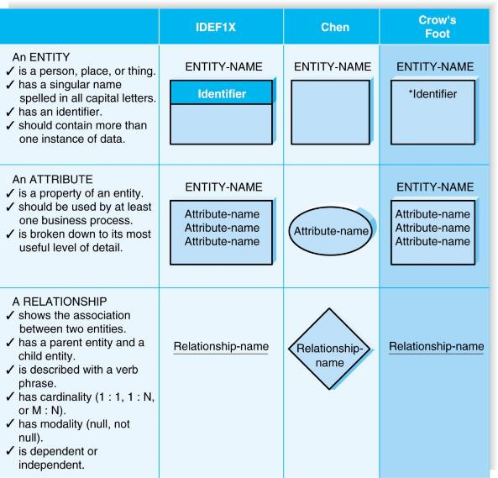
Elements of ERD: Entity Attribute Relationship

Slide 23
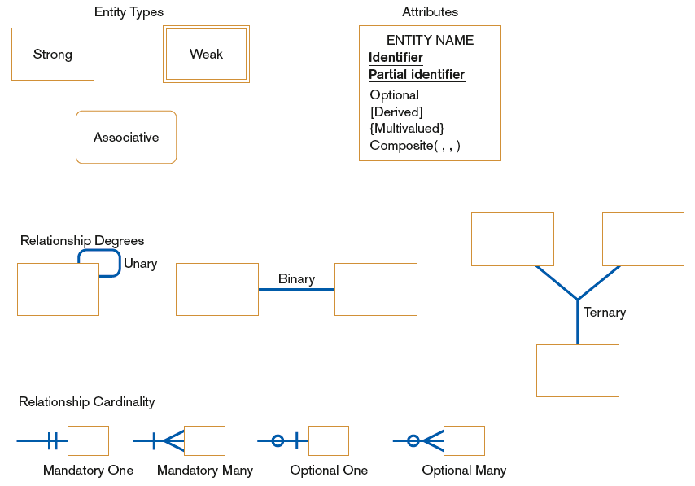
ERD notation

Slide 24
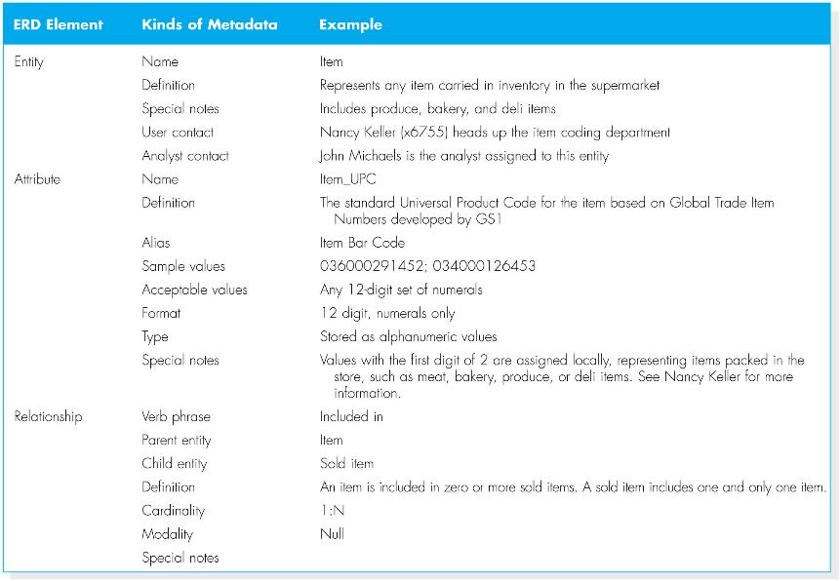

Slide 25
References
Dennis, A., and Wixom, B. H, “Systems Analysis and Design”, 5th Edition, John Wiley & Sons (2013), Chapter Six.
Hoffer, J. A., George, J. F., Valacich J. S., “Modern Systems Analysis and Design”, 7th Edition, Pearson Education. Chapter Eight.

